Slide 1
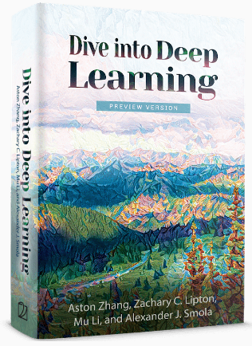
Dive into Deep Learning
Chapter 2:
Preliminaries Automatic Differentiation

Slide 2
Contents
Data Manipulation
Reading the Dataset
Handling Missing Data
Linear Algebra
Scalars
Automatic Differentiation
Probability
Calculus
Documentation
Data Preprocessing
Conversion to the Tensor Format
Matrices
Tensors
Getting Started
Operations
Broadcasting Mechanism
Indexing and Slicing
Saving Memory
Conversion to Other Python Objects
Vectors
Basic Properties of Tensor Arithmetic
Derivatives and Differentiation
Partial Derivatives
Gradients
Chain Rule
A Simple Example
Backward for Non-Scalar Variables
Detaching Computation
Computing the Gradient of Python Control Flow
Basic Probability Theory
Dealing with Multiple Random Variables
Expectation and Variance
Finding All the Functions and Classes in a Module
Finding the Usage of Specific Functions and Classes
+6 sections
Linear Algebra cont.
Reduction
Dot Products
Matrix-Vector Products
Matrix-Matrix Multiplication
Norms
More on Linear Algebra

Slide 3
Contents
CH2
Data Manipulation
Data Preprocessing
Linear Algebra
Linear Algebra cont.
Calculus
Automatic Differentiation
Probability
Documentation
Getting Started
Reading the Dataset
Scalars
Reduction
Derivatives and Differentiation
A Simple Example
Basic Probability Theory
Finding All the Functions and Classes in a Module
Operations
Handling Missing Data
Vectors
Dot Products
Partial Derivatives
Backward for Non-Scalar Variables
Dealing with Multiple Random Variables
Finding the Usage of Specific Functions and Classes
Broadcasting Mechanism
Conversion to the Tensor Format
Matrices
Matrix-Vector Products
Gradients
Detaching Computation
Expectation and Variance
Indexing and Slicing
Tensors
Matrix-Matrix Multiplication
Chain Rule
Computing the Gradient of Python Control Flow
Saving Memory
Basic Properties of Tensor Arithmetic
Norms
Conversion to Other Python Objects
+6 sections
More on Linear Algebra

Slide 4
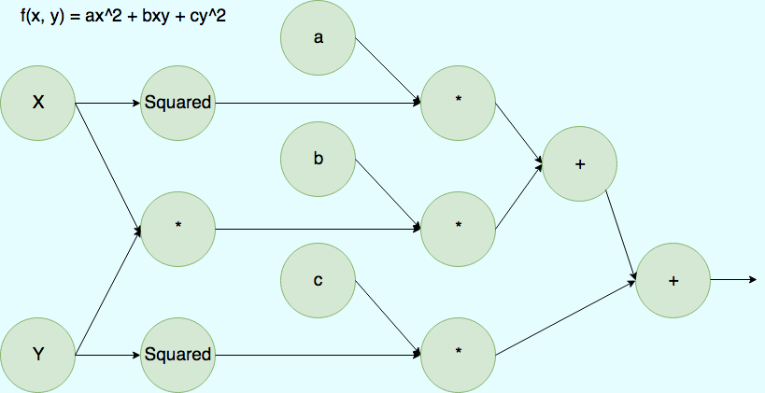
Automatic Differentiation
Differentiation is a crucial step in nearly all deep learning optimization algorithms.
Basic calculus for complex models can be a pain (and often error-prone).
Deep learning frameworks expedite this work by automatically calculating derivatives, i.e., automatic differentiation.
In practice, based on our designed model the system builds a computational graph.
A computational graph is a way to represent a math function in the language of graph theory.
The computational graph is used for tracking which data combined through which operations to produce the output.
Computational graph for the function f(x,y) = ax^2 + bxy +cy^2

Slide 5
Automatic Differentiation
Automatic differentiation enables the system to subsequently backpropagate gradients.
Backpropagate means to trace through the computational graph, filling in the partial derivatives with respect to each parameter.
from mxnet import autograd, np, npx
npx.set_np()

Slide 6
Contents
CH2
Data Manipulation
Data Preprocessing
Linear Algebra
Linear Algebra cont.
Calculus
Automatic Differentiation
Probability
Documentation
Getting Started
Reading the Dataset
Scalars
Reduction
Derivatives and Differentiation
A Simple Example
Basic Probability Theory
Finding All the Functions and Classes in a Module
Operations
Handling Missing Data
Vectors
Dot Products
Partial Derivatives
Backward for Non-Scalar Variables
Dealing with Multiple Random Variables
Finding the Usage of Specific Functions and Classes
Broadcasting Mechanism
Conversion to the Tensor Format
Matrices
Matrix-Vector Products
Gradients
Detaching Computation
Expectation and Variance
Indexing and Slicing
Tensors
Matrix-Matrix Multiplication
Chain Rule
Computing the Gradient of Python Control Flow
Saving Memory
Basic Properties of Tensor Arithmetic
Norms
Conversion to Other Python Objects
+6 sections
More on Linear Algebra

Slide 7
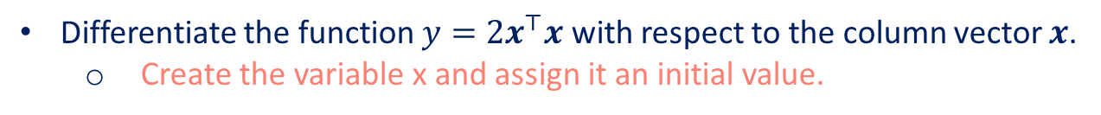

A Simple Example
Differentiate the function $y=2x^{⊤}x$ with respect to the column vector $x$.
Create the variable x and assign it an initial value.
x = np.arange(4.0)
x
The gradient of a scalar-valued function with respect to a vector $x$ is itself vector-valued and has the same shape as $x$.
Before we even calculate the gradient of $y$ with respect to $x$, we will need a place to store it.
# We allocate memory for a tensor's gradient by invoking `attach_grad`
x.attach_grad()
# After we calculate a gradient taken with respect to `x`, we will be able to
# access it via the `grad` attribute, whose values are initialized with 0s
x.grad
Calculate $y$.
# Place our code inside an `autograd.record` scope to build the computational
# graph
with autograd.record():
y = 2 *np.dot(x,x)
y

Slide 8
A Simple Example
We can automatically calculate the gradient of y with respect to each component of x by calling the function for backpropagation and printing the gradient.
y.backward()
x.grad
The gradient of the function $y=2x^{⊤}x$ with respect to $x$ should be $4x$.
x.grad == 4 *x
Let us calculate another function of x.
with autograd.record():
y = x.sum()
y.backward()
x.grad # Overwritten by the newly calculated gradient

Slide 9
Contents
CH2
Data Manipulation
Data Preprocessing
Linear Algebra
Linear Algebra cont.
Calculus
Automatic Differentiation
Probability
Documentation
Getting Started
Reading the Dataset
Scalars
Reduction
Derivatives and Differentiation
A Simple Example
Basic Probability Theory
Finding All the Functions and Classes in a Module
Operations
Handling Missing Data
Vectors
Dot Products
Partial Derivatives
Backward for Non-Scalar Variables
Dealing with Multiple Random Variables
Finding the Usage of Specific Functions and Classes
Broadcasting Mechanism
Conversion to the Tensor Format
Matrices
Matrix-Vector Products
Gradients
Detaching Computation
Expectation and Variance
Indexing and Slicing
Tensors
Matrix-Matrix Multiplication
Chain Rule
Computing the Gradient of Python Control Flow
Saving Memory
Basic Properties of Tensor Arithmetic
Norms
Conversion to Other Python Objects
+6 sections
More on Linear Algebra

Slide 10
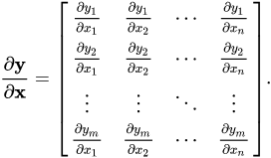
Backward for Non-Scalar Variables
The differentiation of a vector y with respect to a vector x is a matrix.
Source: https://en.wikipedia.org/wiki/Matrix_calculus
For higher-order and higher-dimensional y and x, the differentiation result could be a high-order tensor.
These more exotic objects do show up in advanced machine learning (including in deep learning).
Often, when calling backward on a vector, we are trying to calculate the derivatives of the loss functions for each constituent of a batch of training examples.

Slide 11
Backward for Non-Scalar Variables
Compute the partial derivatives individually for each example in the batch.
Our intent is not to calculate the differentiation matrix.
# When we invoke `backward` on a vector-valued variable `y` (function of `x`),
# a new scalar variable is created by summing the elements in `y`. Then the
# gradient of that scalar variable with respect to `x` is computed
with autograd.record():
y = x * x # `y` is a vector
y.backward()
x.grad # Equals to y = sum(x * x)

Slide 12
Contents
CH2
Data Manipulation
Data Preprocessing
Linear Algebra
Linear Algebra cont.
Calculus
Automatic Differentiation
Probability
Documentation
Getting Started
Reading the Dataset
Scalars
Reduction
Derivatives and Differentiation
A Simple Example
Basic Probability Theory
Finding All the Functions and Classes in a Module
Operations
Handling Missing Data
Vectors
Dot Products
Partial Derivatives
Backward for Non-Scalar Variables
Dealing with Multiple Random Variables
Finding the Usage of Specific Functions and Classes
Broadcasting Mechanism
Conversion to the Tensor Format
Matrices
Matrix-Vector Products
Gradients
Detaching Computation
Expectation and Variance
Indexing and Slicing
Tensors
Matrix-Matrix Multiplication
Chain Rule
Computing the Gradient of Python Control Flow
Saving Memory
Basic Properties of Tensor Arithmetic
Norms
Conversion to Other Python Objects
+6 sections
More on Linear Algebra

Slide 13
Detaching Computation
Sometimes, we wish to move some calculations outside of the recorded computational graph.
Say that y was calculated as a function of x, and subsequently z was calculated as a function of both y and x.
We want to calculate the gradient of z with respect to x, but treat y as a constant, and only take into account the role that x played after y was calculated.
We can detach y to return a new variable u that has the same value as y but discards any information about how y was computed in the computational graph.
The gradient will not flow backwards through u to x.
Thus, the backpropagation function computes the partial derivative of z = u * x with respect to x while treating u as a constant, instead of the partial derivative of z = x * x * x with respect to x.
with autograd.record():
y = x * x
u = y.detach()
z = u * x
z.backward()
print(u)
x.grad == u

Slide 14
Detaching Computation
Since the computation of y was recorded, we can invoke backpropagation on y to get the derivative of y = x * x with respect to x, which is 2 * x.
y.backward()
x.grad == 2 * x

Slide 15
Contents
CH2
Data Manipulation
Data Preprocessing
Linear Algebra
Linear Algebra cont.
Calculus
Automatic Differentiation
Probability
Documentation
Getting Started
Reading the Dataset
Scalars
Reduction
Derivatives and Differentiation
A Simple Example
Basic Probability Theory
Finding All the Functions and Classes in a Module
Operations
Handling Missing Data
Vectors
Dot Products
Partial Derivatives
Backward for Non-Scalar Variables
Dealing with Multiple Random Variables
Finding the Usage of Specific Functions and Classes
Broadcasting Mechanism
Conversion to the Tensor Format
Matrices
Matrix-Vector Products
Gradients
Detaching Computation
Expectation and Variance
Indexing and Slicing
Tensors
Matrix-Matrix Multiplication
Chain Rule
Computing the Gradient of Python Control Flow
Saving Memory
Basic Properties of Tensor Arithmetic
Norms
Conversion to Other Python Objects
+6 sections
More on Linear Algebra

Slide 16
Computing the Gradient of Python Control Flow
One benefit of using automatic differentiation is that:
Even if building the computational graph of a function required passing through a maze of Python control flow, we can still calculate the gradient of the resulting variable.
In the following snippet, the number of iterations of the $while$ loop and the evaluation of the $if$ statement both depend on the value of the input $a$.
def f(a):
b = a * 2
while np.linalg.norm(b) < 1000:
b = b * 2
if b.sum() > 0:
c = b
else:
c = 100 * b
return c
For function $f$, for any a there exists some constant scalar k such that f(a) = k * a, where the value of k depends on the input a. Consequently d / a allows us to verify that the gradient is correct.
a.grad == d/a

Slide 17
Summary
Deep learning frameworks can automate the calculation of derivatives. To use it, we first attach gradients to those variables with respect to which we desire partial derivatives. We then record the computation of our target value, execute its function for backpropagation, and access the resulting gradient.

